Slide 1
The New Alma UI Layout
Yoel Kortick – Senior Librarian

Slide 2
  Introduction
  Changes to the User Interface
  Collapse and Expand the Main Menu Navigation Panel
  Access to Alma Configurations
  Quick Links Improvements – Creating Quick Links
  Quick Links Improvements – Using Quick Links
  Customizing the Main Menu Links
  Customizing the Main Menu Icons
  Automatic adjustment for resolution

Slide 3


Introduction

Slide 4
Introduction
The new Alma UI layout
  Increases the working area of staff user
  Improves navigation
  Provides additional options for menu customization
  Facilitates improved user workflows.
This presentation will outline these new features.

Slide 5
Introduction
This presentation is designed to be accompanied by a live demo.
It does have value however also as a ‘standalone’ presentation.

Slide 6

Changes to the User Interface

Slide 7
Changes to the User Interface – Navigation Bar
The Navigation bar (the Main Menu Navigation bar on Alma Menu pages, or the Alma Configuration bar on the Alma Configuration pages) changed location:
  In the old UI it was in the header
  In the new UI it is on the left side as a left-side panel
The navigation bar can be collapsed to provide more room on the page while remaining visible.

Slide 8
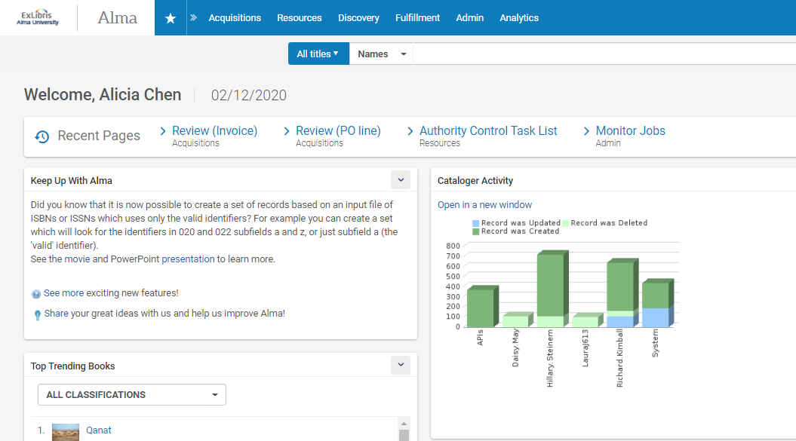
Changes to the User Interface – Navigation Bar
Old UI

Slide 9
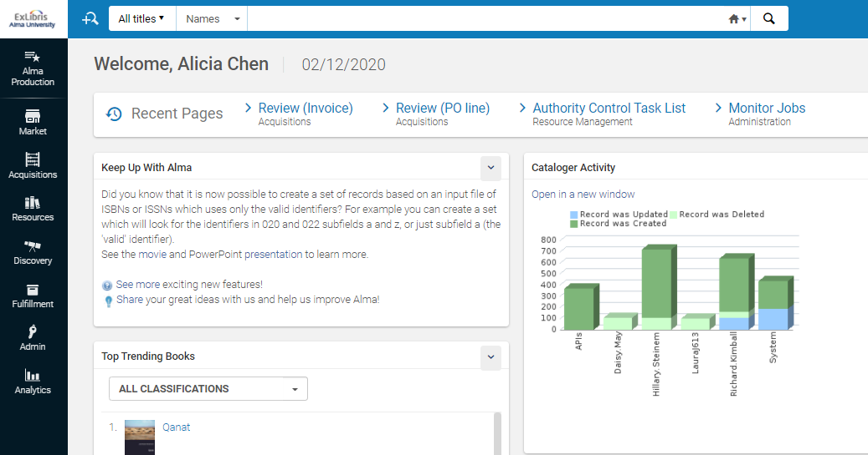
Changes to the User Interface – Navigation Bar
New UI

Slide 10
Changes to the User Interface – Persistent Search
The Persistent search box was moved to the header and combined with the Main Menu Icons bar.
It is now always available on all Alma Menu pages.
The Advanced Search option is now designated by the advanced search icon and is located before the Persistent search box.

Slide 11
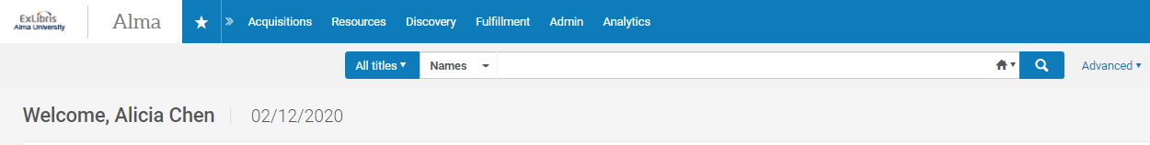
Changes to the User Interface – Persistent Search
Old UI

Slide 12
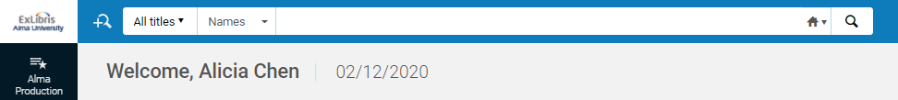
Changes to the User Interface – Persistent Search
New UI

Slide 13
Changes to the User Interface – Configuration Navigation
The Alma Configuration navigation was improved by integrating it to the Main Menu.
The icon that opens the Alma Configurations page was moved from the Main Menu icons bar to the Main Menu Navigation panel.

Slide 14
Changes to the User Interface – Configuration Navigation
Old UI

Slide 15
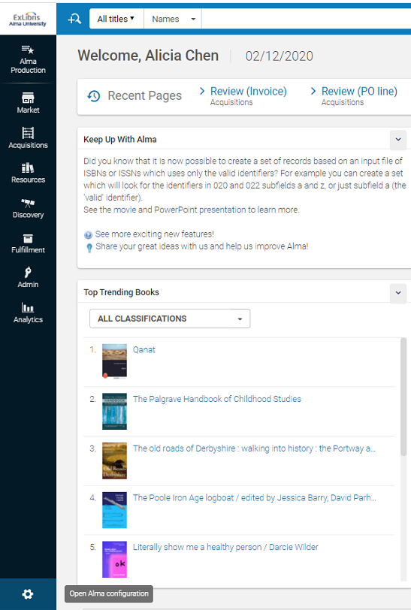
Changes to the User Interface – Configuration Navigation
New UI

Slide 16
Changes to the User Interface – Improved Quick Links
The improved Quick Links control now enables the staff user to customize Quick Links and to view the Quick Links alongside the Main Alma Menu at the same time.
Previously the staff user could see either the Main menu or the customized Quick Links at any one time.
The improvements to the Quick Links include a faster way of creating Quick Links, the ability to pin Quick Links to the page to display like another menu, and hotkeys that enable the staff user to open the Quick Links by using the keyboard.

Slide 17
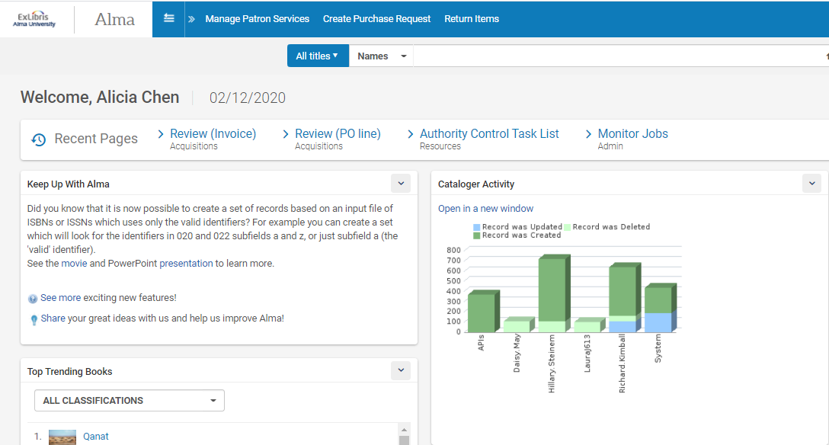
Changes to the User Interface – Improved Quick Links
Old UI

Slide 18
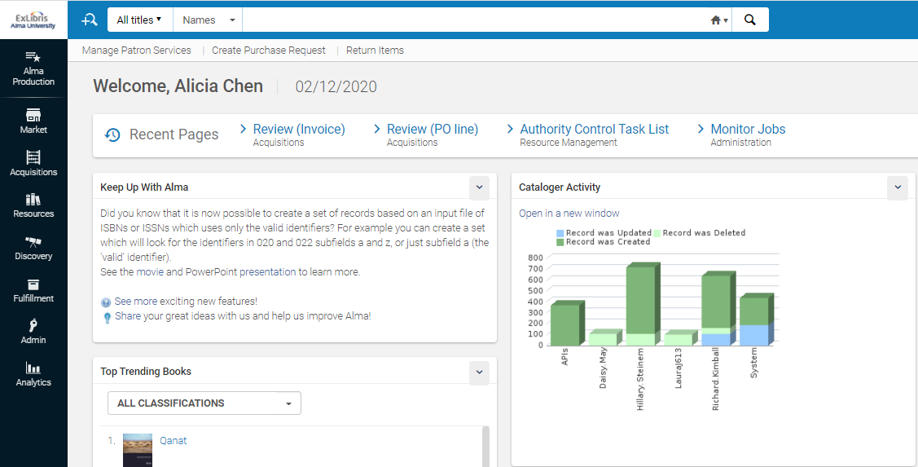
Changes to the User Interface – Improved Quick Links
New UI

Slide 19
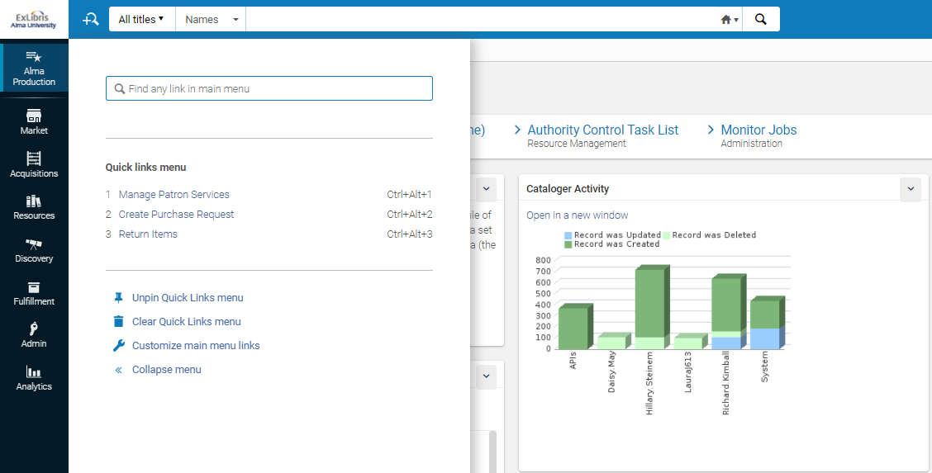
Changes to the User Interface – Improved Quick Links
New UI

Slide 20
Changes to the User Interface – Order of Links and Icons
The staff user can determine the order in which the Main Menu links and Main Menu icons appear on the screen
It is also possible to hide the links and icons which are not used (or used infrequently)
This reduces the amount of visual information on the screen.

Slide 21
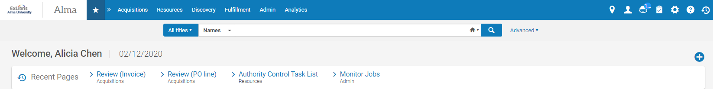
Changes to the User Interface – Order of Links and Icons
Old UI
The order and appearance of these menu entries and icons cannot be changed

Slide 22
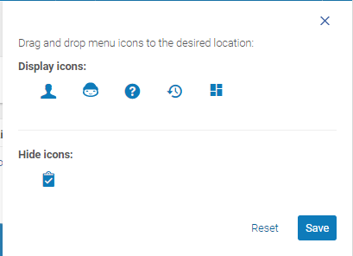

Changes to the User Interface – Order of Links and Icons
New UI
We have removed the task list icon

Slide 23
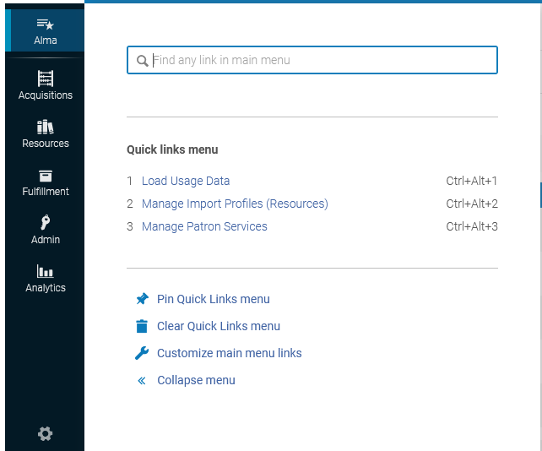
Changes to the User Interface – Order of Links and Icons
New UI
Click top left ‘Search and manage Alma links” and then “Customize main menu links”

Slide 24
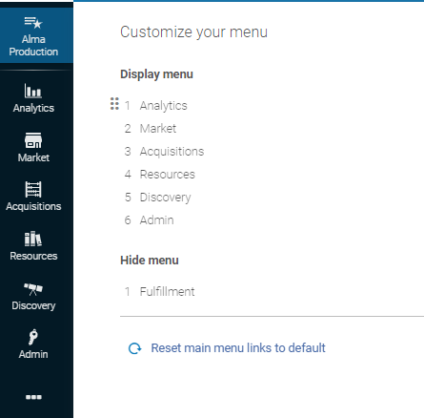
Changes to the User Interface – Order of Links and Icons
New UI
We have removed the “fulfillment” menu entry and moved “Analytics” to the top.
Note that hidden entries will not appear in the left pane, but will appear when clicking the three dots here

Slide 25
Changes to the User Interface – Summary Section
On all pages that have a summary section containing read-only information about the displayed entity, this section was moved to the right-hand panel.
This allows the staff user to see more dynamic information for the entity he or she is working with, along with the static information for this entity.

Slide 26
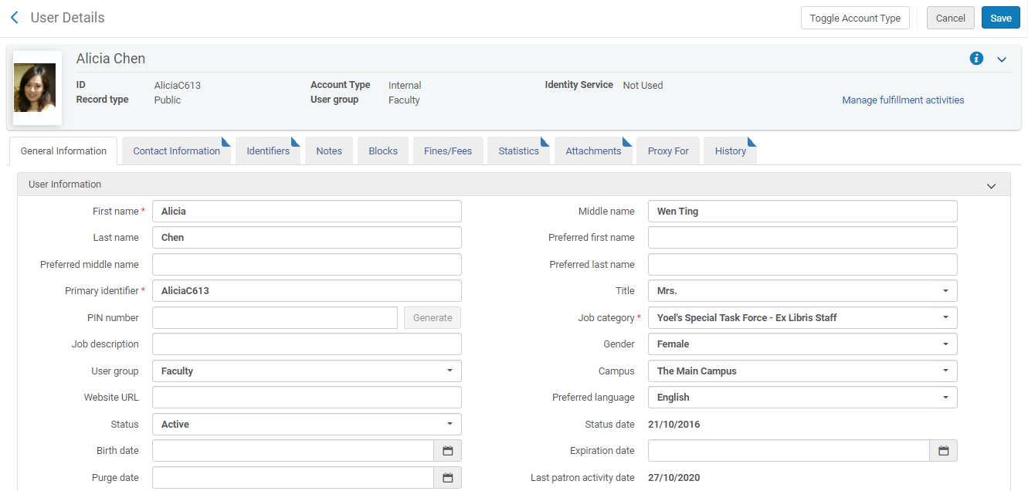
Changes to the User Interface – Summary Section
Old UI

Slide 27
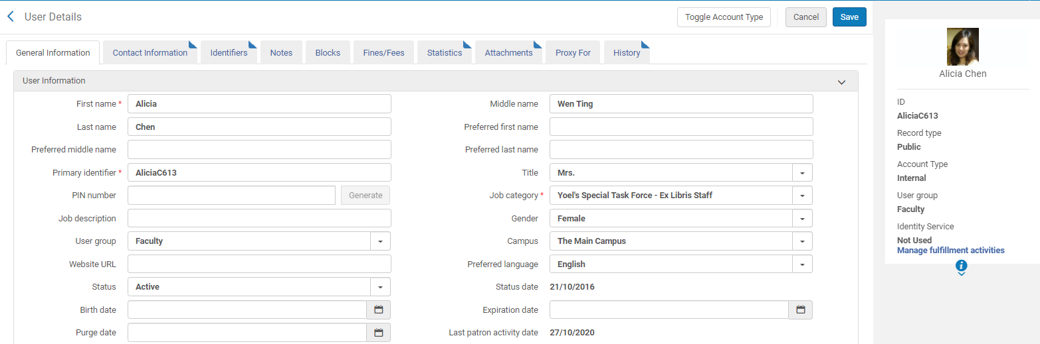
Changes to the User Interface – Summary Section
New UI

Slide 28
Changes to the User Interface – Task List Panel
The Task list was changed to a panel that can be collapsed to provide more room on the page.

Slide 29
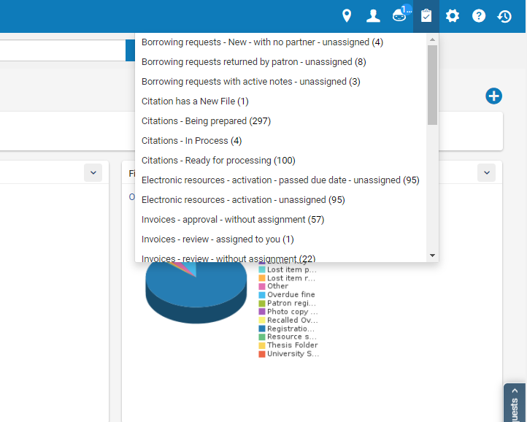
Changes to the User Interface – Task List Panel
Old UI

Slide 30
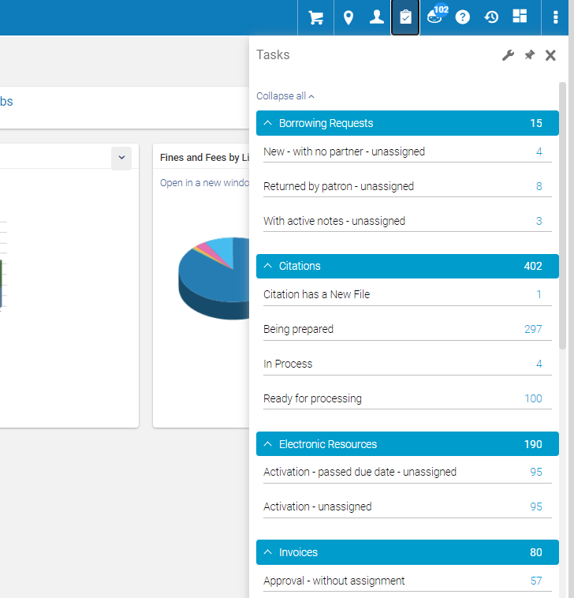
Changes to the User Interface – Task List Panel
New UI

Slide 31

Collapse and Expand the Main Menu Navigation Panel

Slide 32
Collapse and Expand the Main Menu Navigation Panel
As we have already seen, the Main Menu Navigation bar changed location from the header to the left side.
In addition to changing location, it is now a left-side panel that can be collapsed to provide more room on the page while still remaining visible.
It can be expanded again at any time.

Slide 33
Collapse and Expand the Main Menu Navigation Panel
To collapse the Main Menu Navigation panel:
Click “Search and Manage Alma Links” on the Main Menu
Select the Collapse left menu option.
To return to the Expanded view, select Expand left menu.

Slide 34
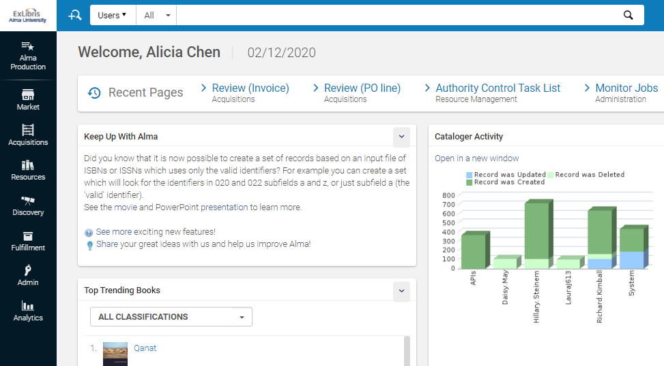
Collapse and Expand the Main Menu Navigation Panel
Click here

Slide 35
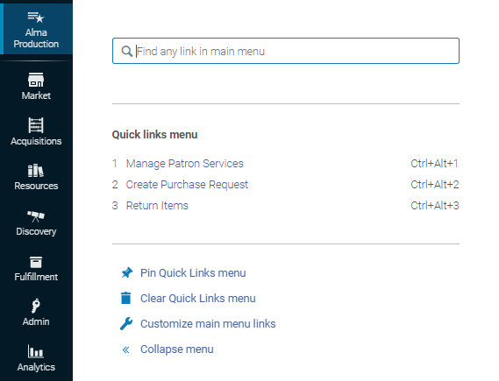
Collapse and Expand the Main Menu Navigation Panel
Collapse the menu

Slide 36
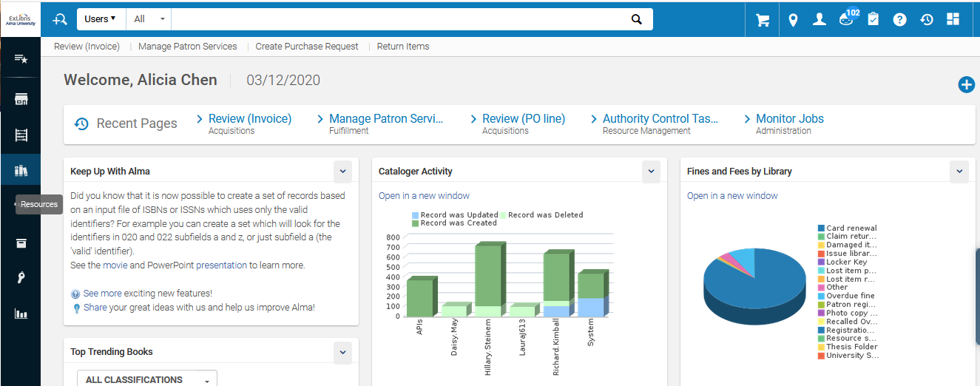
Collapse and Expand the Main Menu Navigation Panel
See that now the main Menu Navigation Panel is much narrower than it previously was, and there are only icons with no words. Note however that there are pop up texts.

Slide 37
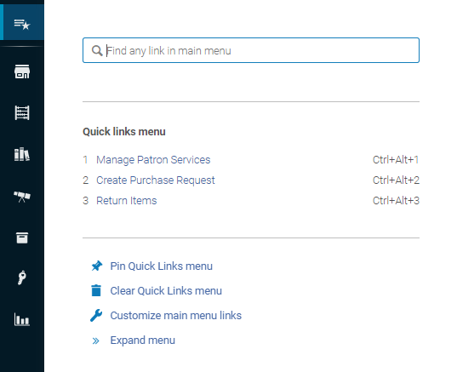
Collapse and Expand the Main Menu Navigation Panel
The menu can then be “Expanded” again when desired.

Slide 38

Access to Alma Configurations

Slide 39
Access to Alma Configurations
Access to Alma Configurations was changed significantly to allow the staff user to switch easily and quickly between ongoing main-workflow tasks and any peripheral tasks that he or she might want to perform in Alma Configurations.
As we have already seen, the icon that opens the Alma Configurations was moved from the Main Menu to the bottom of the Main Menu Navigation bar.

Slide 40
Access to Alma Configurations
To open Alma Configuration:
Select the configuration icon. The following changes take place:
  The Alma Main Menu changes to the Alma Configuration Menu.
    To distinguish the configuration menu from the Alma menu, the bar color changes to the default primary color in the user interface, and its icons feature a cog wheel to distinguish them from the regular Alma icons.
  The persistent search bar disappears, and the dropdown of units to configure appears instead.
  Instead of the main Alma window, a dedicated screen opens.
In the top dropdown, select the unit to configure.
Select the functional area and desired menu entry
To close Alma Configuration and return to the Alma menu select the back to Alma icon.

Slide 41
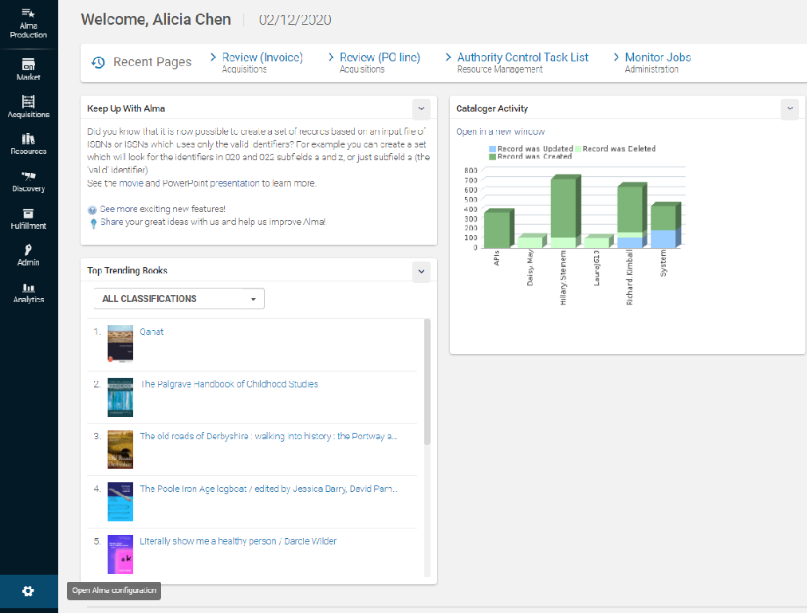
Access to Alma Configurations
Access the configuration via the icon. Ctrl+Alt+C can be used to toggle between the Alma menu and the configuration menu.

Slide 42
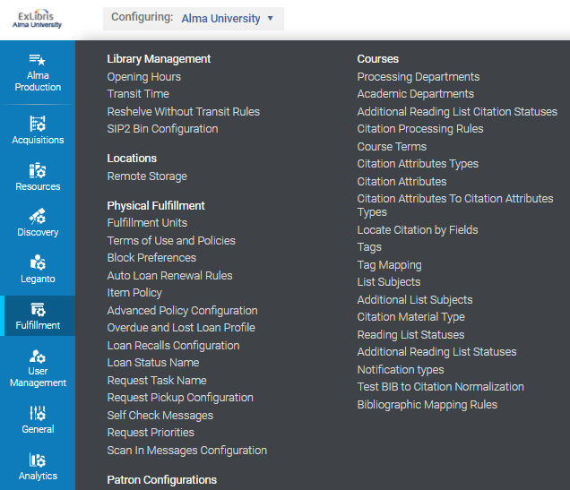
Access to Alma Configurations
The “Persistent Search” bar no longer appears. Choose the institution or a library to configure
The bar color changes to the default primary color in the user interface, and its icons feature a cog wheel to distinguish them from the regular Alma icons
Select a functional area to configure.

Slide 43
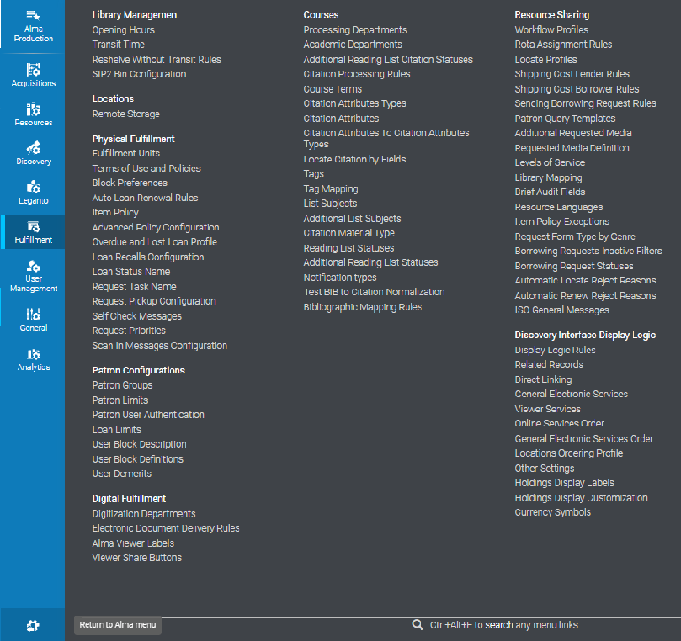
Access to Alma Configurations
To close Alma Configuration and return to the Alma menu, select the “back to Alma” icon.

Slide 44

Quick Links Improvements – Creating Quick Links

Slide 45
Quick Links Improvements – Creating Quick Links
Alma tools that are used frequently can be set as Quick Links.
In this manner the Alma interface is personalized to each user’s workflow, eliminating the need for he or she to go through the sub-menus every time.
In addition to the existing method of creating Quick Links (which still exists), there is now an additional faster method to create them.

Slide 46
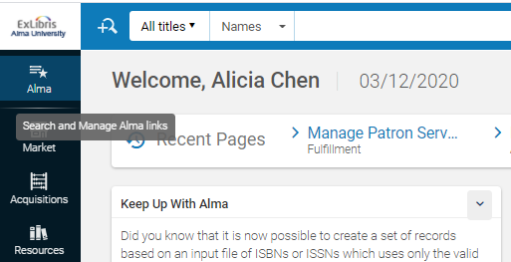
Quick Links Improvements – Creating Quick Links
First: click the “Search and manage Alma Links” icon.
First: click the “Search and manage Alma Links” icon.

Slide 47
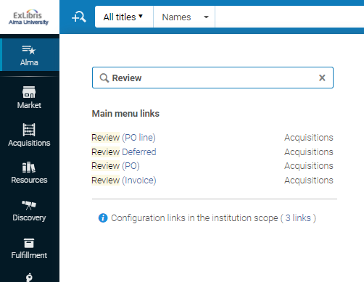
Quick Links Improvements – Creating Quick Links
Second: in the top search bar, start typing the name of the menu entry which is desired to be the Quick Link
We typed in “Review”
We got four results
We also see that there are 3 menu entries for “Review” in the “Configuration” menu and we have a link to see them.

Slide 48
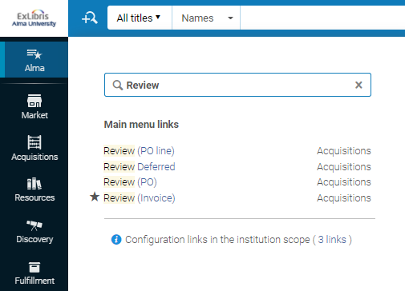
Quick Links Improvements – Creating Quick Links
Third: Hover mouse over desired entry and click the grey star next to it.
We will click the grey star at “Review (Invoice)” (the star is there because we hovered the mouse in the entry)

Slide 49
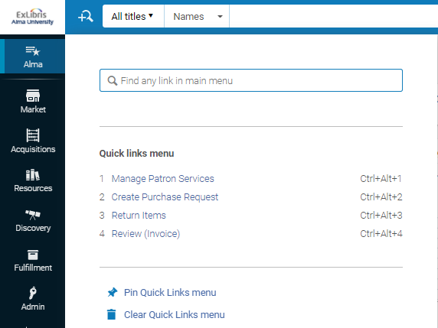
Quick Links Improvements – Creating Quick Links
The changes are automatically saved. Now the new Quick Link is saved
We just now added this one

Slide 50

Quick Links Improvements – Using Quick Links

Slide 51
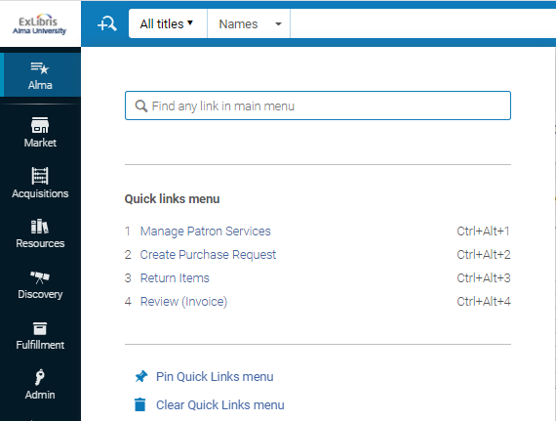
Quick Links Improvements – Using Quick Links
The Quick Links can be viewed by clicking the “Search and Manage Alma Links” icon.
Ctrl+Alt+F can also be used.

Slide 52
Quick Links Improvements – Using Quick Links
The Quick Links can be used by using the automatically assigned hot keys (for example Ctrl+Alt+4 for “Review (Invoice)”)

Slide 53
Quick Links Improvements – Using Quick Links
The Quick Links can be pinned as an additional menu on the Alma page below the Persistent Search box. This can be done by clicking “Pin Quick Links menu”.

Slide 54
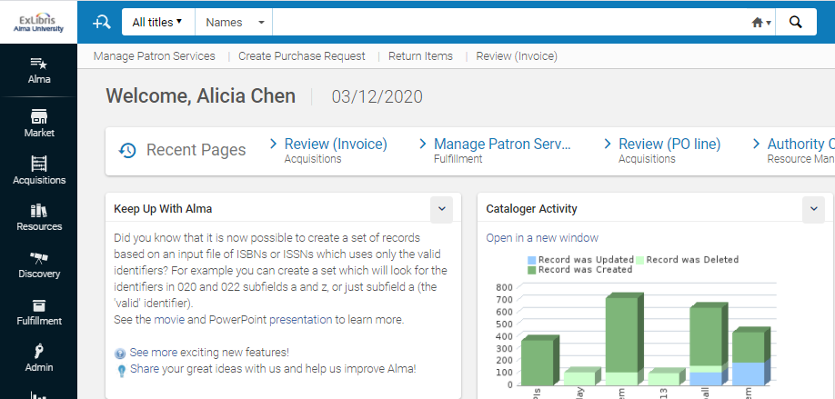
Quick Links Improvements – Using Quick Links
The Quick Links have been pinned

Slide 55
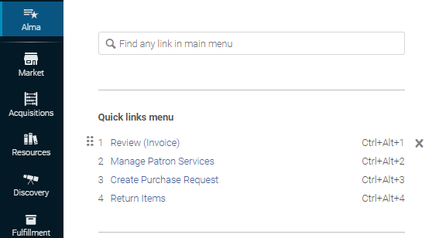
Quick Links Improvements – Using Quick Links
It is also possible to drag and drop the quick links to change the order.
We have dragged “Review (Invoice)” to be first.

Slide 56
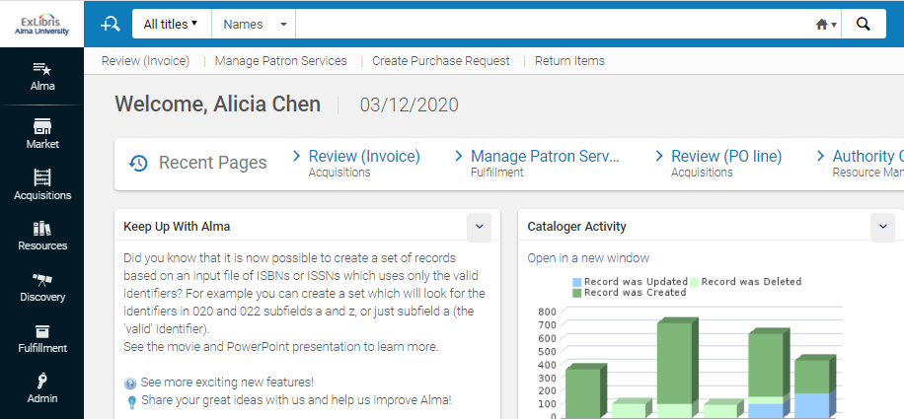
Quick Links Improvements – Using Quick Links
The “Quick Links” order has correspondingly changed

Slide 57

Customizing Main Menu Links

Slide 58
Customizing Main Menu Links
It is possible to determine the order in which the Main Menu links and Main Menu icons appear on the screen.
Further, it is possible to hide the links and icons that are not needed.
This is beneficial as it will reduce the amount of visual information on the screen and clear the room for more important information.

Slide 59
Customizing Main Menu Links
First: click the “Search and Manage Alma Links” icon.

Slide 60
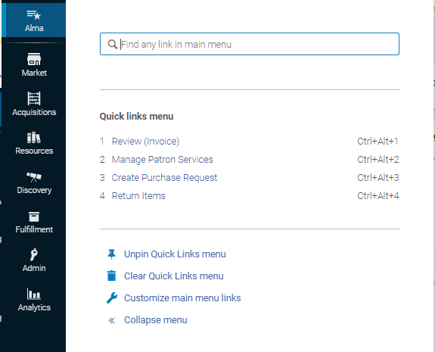
Customizing Main Menu Links
Second: Select the Customize Main Menu Links option.

Slide 61
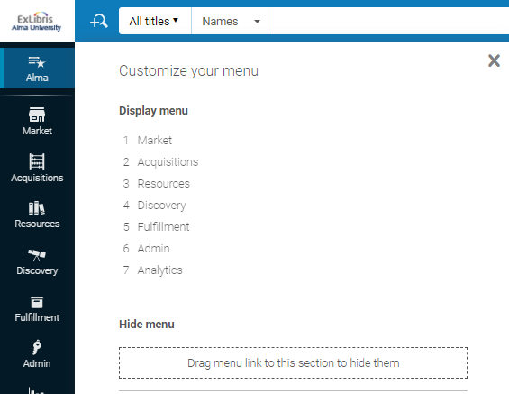
Customizing Main Menu Links
Three: The current situation of the menu appears

Slide 62
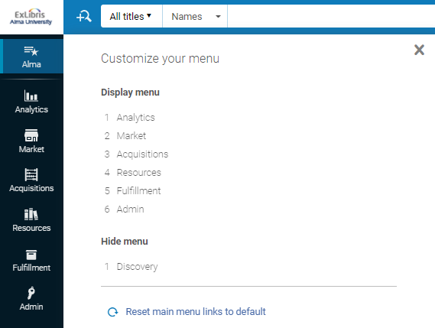
Customizing Main Menu Links
Four: Customize as desired.
We have dragged “Analytics” to be first and dragged “Discovery” to be hidden.

Slide 63
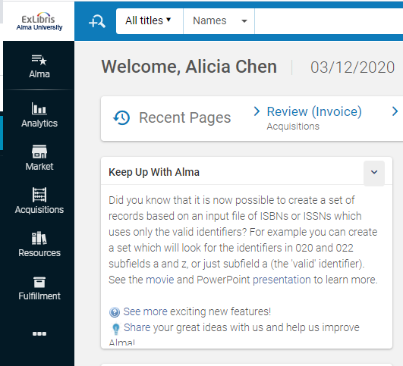
Customizing Main Menu Links
Now Analytics is first and Discovery does not appear

Slide 64
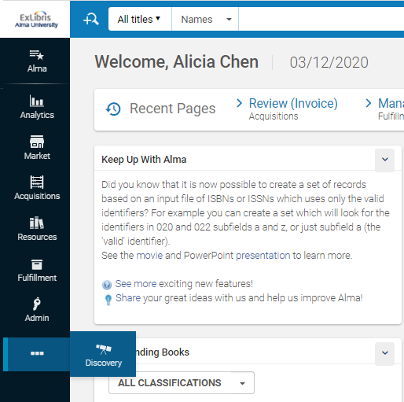
Customizing Main Menu Links
The “Hidden” menus can be seen via the ellipses

Slide 65

Customizing Main Menu Icons

Slide 66
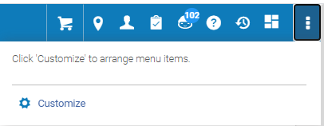
Customizing Main Menu Icons
In the Main Menu Icons bar, select the ellipsis button and select Customize.

Slide 67
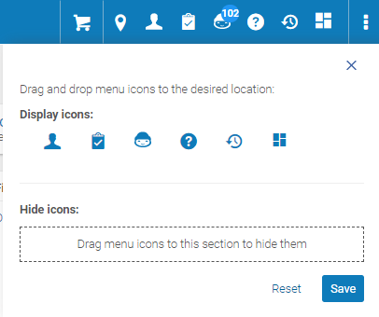
Customizing Main Menu Icons
A panel with the icons opens.

Slide 68
Customizing Main Menu Icons
Drag-and-drop the icons to change the order in which they are displayed, or drag and drop to the Hide Icons section to hide them.

Slide 69
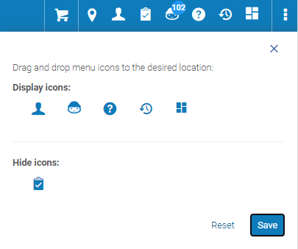
Customizing Main Menu Icons
Here we have hidden the Tasks List icon and clicked “Save”

Slide 70

Customizing Main Menu Icons
Now we no longer see the Tasks List icon

Slide 71
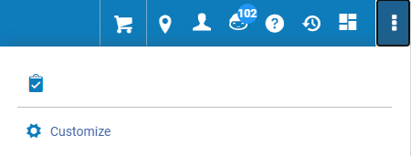
Customizing Main Menu Icons
The hidden icons are still visible via the ellipses

Slide 72

Automatic adjustment for resolution

Slide 73
Automatic adjustment for resolution
As the resolution of the users’ screens may differ, the appearance of the icons and data on the Alma screen accordingly adjusts.
This allows for a comfortable viewing experience.

Slide 74
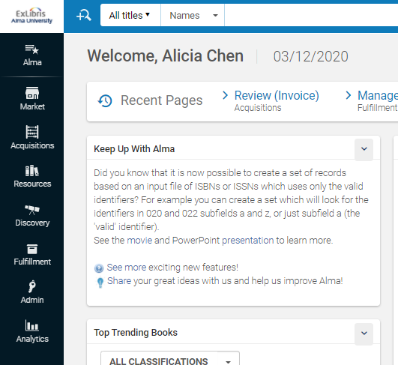
Automatic adjustment for resolution
Here are the main menu links with a “small” resolution

Slide 75
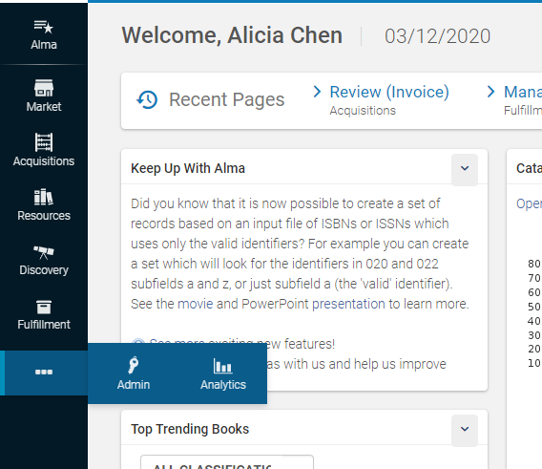
Automatic adjustment for resolution
Here are the main menu links with a “larger” resolution
The links which do not fit automatically are accessible via the “ellipses”

Slide 76
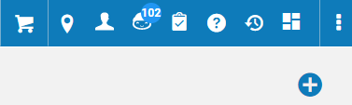
Automatic adjustment for resolution
Here are the main menu icons with a “small” resolution

Slide 77
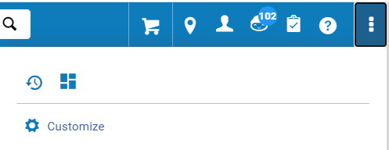
Automatic adjustment for resolution
Here are the main menu icons with a “larger” resolution
The icons which do not fit automatically are accessible via the “ellipses”

Slide 78
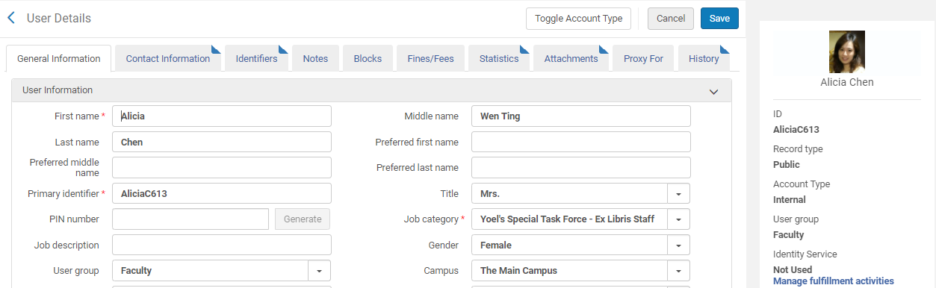
Automatic adjustment for resolution
Here is a user record with a “small” resolution
The summary section is on the right.

Slide 79
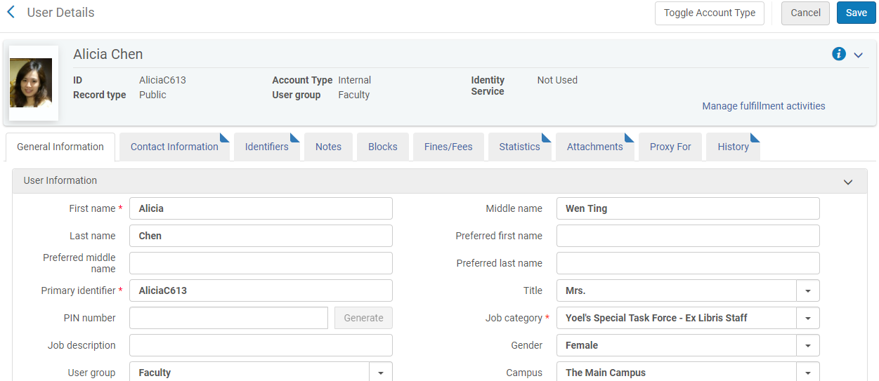
Automatic adjustment for resolution
Here is a user record with a “larger” resolution
The summary section moved from the left to the top.

Slide 80
xxx@exlibrisgroup.com

